Slide 1

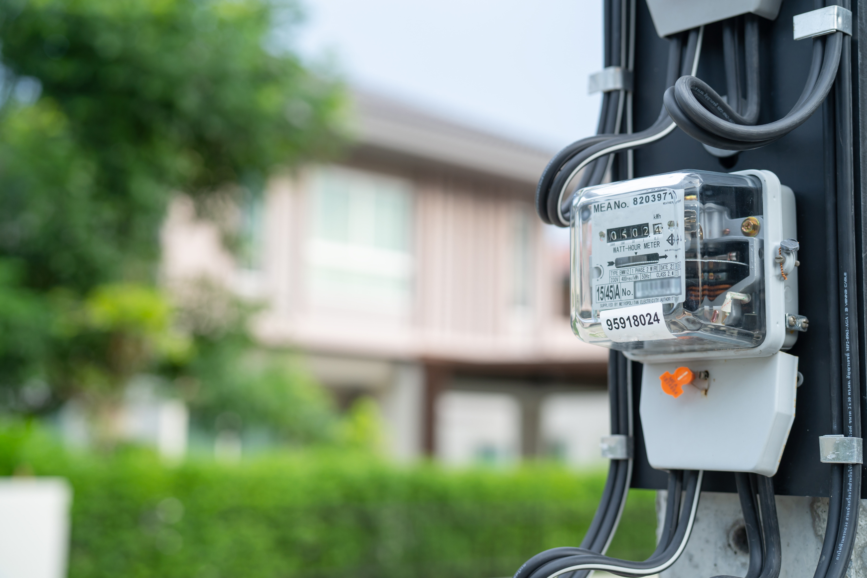
Project Title :
Energy Consumption
Estimator
Team Members: Mihir Bhayani, Parth Tank, Khilan Kalavadiya, Himanshu Mehta
Course: MCA – 1st Year
University: Dr. D. Y. Patil University (DPU)
Tools Used: HTML, CSS, JavaScript, Python,
SQLite3

Slide 2
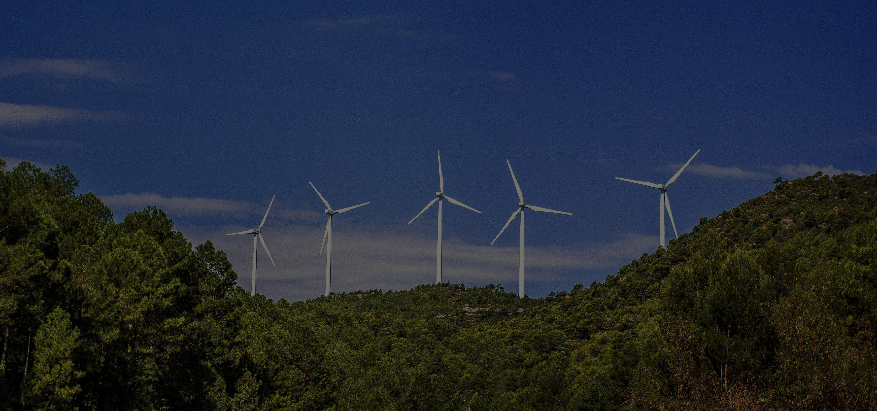
Energy Consumption Estimator :
An Overview
Purpose of the System
Target Users and Functionalities
Key Outcomes and Benefits
The Energy Consumption Estimator aims to simplify how users understand and manage electricity usage.
It calculates power consumption and cost in Indian Rupees (₹) based on each appliance’s wattage and usage time.
By displaying total daily, monthly, and yearly consumption, it helps users and admins track, analyze, and reduce energy usage effectively.
Admin :
Manages customers, appliances, and energy data. Admin can add, edit, or delete records, view real-time charts, and generate downloadable PDF reports for cost summaries.
Customer :
Views their personal energy usage, cost analysis, and energy-saving suggestions.
The system ensures a separate and secure dashboard for both roles with clear insights and interactive charts.
This project acts as a smart energy assistant, combining data analysis with sustainability awareness.
It helps detect high-consumption devices, provides instant visual reports, and motivates users to save electricity.
Overall, it enhances energy efficiency, promotes cost transparency, and contributes to environmental conservation.

Slide 3
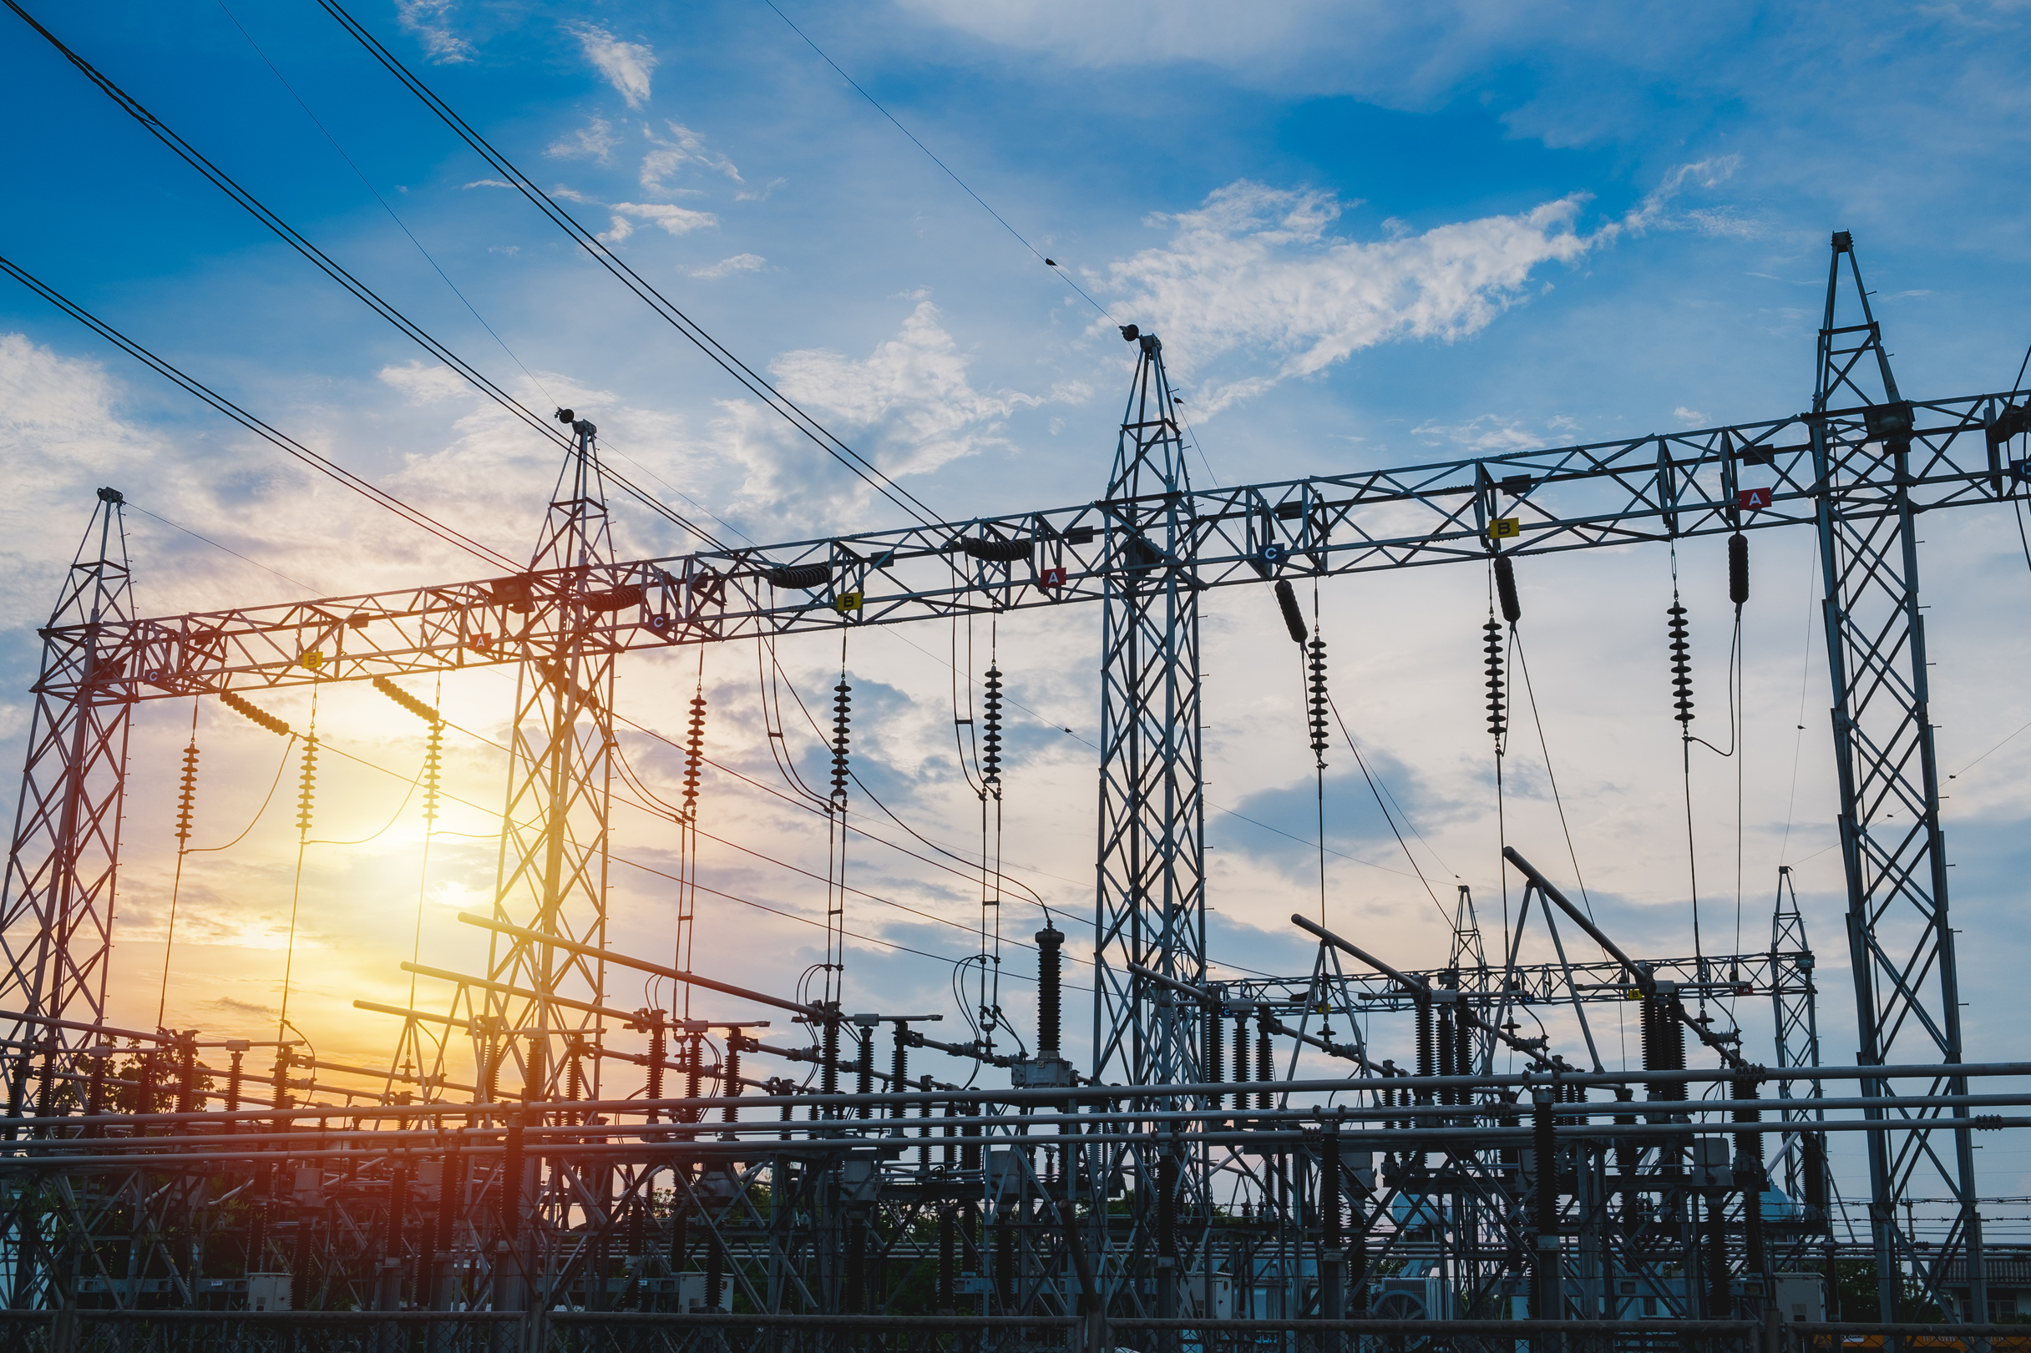
Objectives of
Energy
Consumption Estimator
Accurate Energy Cost Calculation
Interactive Monitoring & Data Visualization
The system automatically calculates daily, monthly, and yearly electricity costs in Indian Rupees (₹) based on appliance power ratings and usage hours.
It ensures precise results by applying the fixed cost rate of ₹8.00 per kilowatt-hour (kWh) for every usage record.
The project enables users and admins to analyze energy patterns visually using interactive charts and graphs.
These visuals help identify high-energy-consuming appliances and track overall consumption trends for better decision-making.
Efficient Management & Reporting
Admins can efficiently manage customers, appliances, and usage records through a centralized dashboard.
All data can be exported into PDF reports for quick reviews, summaries, and official documentation.

Slide 4

S y s t e m
D e s i g n
Frontend (Presentation Layer)
Backend (Application Logic Layer)
Database (Data Layer)
Built using SQLite3 for lightweight and reliable data storage.
Stores data in multiple tables:
login (admin credentials)
customer (customer details)
application (list of 50 predefined appliances and their wattages)
customer_application (each user’s usage and cost data)
Provides a structured foundation for persistent data management.
Built using HTML, CSS, and JavaScript.
Provides an interactive, single-page dashboard for both Admin and Customer.
Uses Tailwind CSS for styling, Chart.js for graphical reports, and jsPDF for generating downloadable PDF reports.
Handles all user interactions, data display, and dynamic chart updates.
Developed in Python using the Flask framework.
Acts as the bridge between the frontend and the database.
Handles all business logic, such as energy cost calculations, authentication, CRUD operations (Create, Read, Update, Delete), and API requests.
Ensures secure communication between user actions and the database.

Slide 5
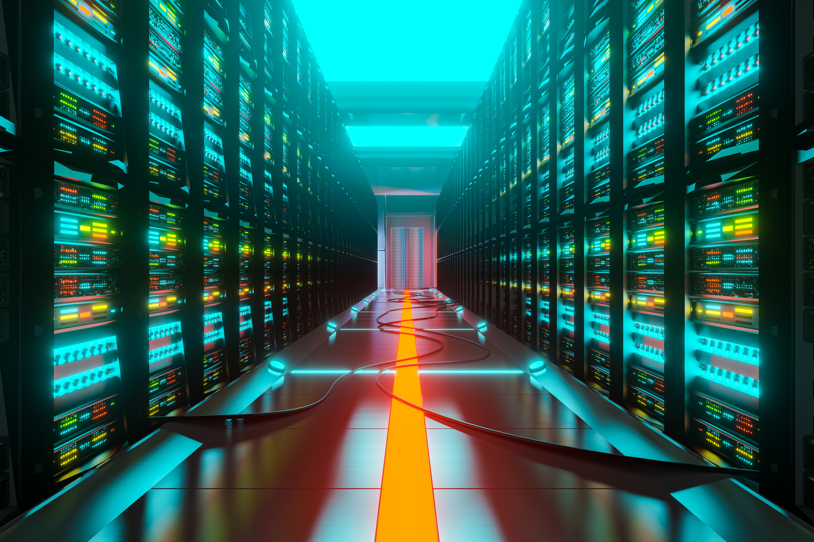
Database
Design
The Energy Consumption Estimator project uses a relational database (SQLite3) to store, manage, and retrieve all application and customer-related information efficiently.
The database is designed with data normalization, referential integrity, and clear relationships between tables to ensure smooth operation and accurate calculations.
Database Overview
Database Name: energy_estimator.db
Type: Relational Database (SQLite3)
Connection File: app_database.py
Purpose: To store customer details, appliance data, and daily energy usage records for cost estimation and reporting.
Relationships Between Tables
One-to-Many:
One customer can have many energy usage entries in the customer_application table.
Foreign Keys:
customer_id (from customer_application) references customer.
application_name (from customer_application) references application.
This maintains data integrity and ensures all usage data is correctly linked to both the customer and the selected appliance.

Slide 6
Database
Design
Main Tables & Their Structure
Table Name | Fields / Columns | Description
login | username (PK), password | Stores admin login credentials.
customer | customer_id (PK), customer_name, email_id, phone_no, password | Contains user information and contact details.
application | application_name (PK), watts | Stores the 50 predefined household or office appliances and their power ratings.
customer_application | cust_app_id (PK), customer_id (FK), application_name (FK), qty, date_time, watts, hours_day, daily_kwh, daily_cost | Records each customer’s appliance usage, including cost and energy consumed per day.

Slide 7

Software Tools and
Technologies
Frontend Technologies
Backend Technologies
Database Technologies
The frontend is developed using HTML, CSS, and JavaScript to create an interactive and responsive user interface.
It uses Tailwind CSS for modern styling, Chart.js for visual charts, and jsPDF for generating downloadable PDF reports.
This ensures a smooth user experience for both admin and customer dashboards.
The backend is built using Python with the Flask framework, which handles all business logic and communication between the frontend and database.
It performs core functions such as energy cost calculations, data management, authentication, and API handling.
Flask ensures fast, scalable, and secure data processing.
The system uses SQLite3 as its database, managed through Python scripts.
It stores information about customers, appliances, and usage records in structured tables with primary and foreign key relationships.
SQLite3 provides lightweight, reliable, and efficient data storage for this energy-tracking system.

Slide 8

Core
Functionalities
Energy Calculation and Analysis
Data Management and Reporting
The system automatically calculates daily, monthly, and yearly energy costs based on appliance wattage, usage hours, and quantity.
It uses a fixed electricity rate of ₹8.00 per kWh to estimate the total energy cost.
All usage data is analyzed and displayed with interactive charts and summary cards, helping users track their energy consumption patterns easily.
Admins can add, edit, and delete customer records and energy usage data directly through the dashboard.
The system generates real-time reports and allows exporting them as PDF files using jsPDF.
This helps in maintaining organized records, simplifying report generation, and ensuring accurate data handling.
User Roles and Interactive Dashboard
The project provides two separate interfaces — one for Admin and one for Customer.
Admins can manage all customers and view overall statistics, while customers can only view their personal usage and cost data.
The dashboard includes dynamic charts, real-time notifications, and energy-saving tips, making the interface both professional and user-friendly.

Slide 9

Energy Saving
Tips & Solution
Context-Based Recommendations
Promoting Sustainable Practices
Smart Energy Awareness
The system includes a built-in feature that provides energy-saving suggestions for each appliance.
Whenever users view or select an appliance, the system displays related practical tips to help minimize electricity consumption.
This encourages users to make smarter and more eco-friendly choices in their daily energy usage.
Energy-saving tips are dynamic and context-based, meaning they change according to the appliance or data being viewed.
For example, when a user selects an air conditioner or heater, the system suggests ways to reduce power load — such as setting optimal temperatures or limiting usage time.
This makes energy conservation more personalized and effective.
Beyond just calculation and reporting, the project aims to spread energy conservation awareness.
By providing real-time saving suggestions and highlighting power-hungry devices, it helps users reduce energy costs and carbon footprint.
This aligns the system’s goal with the idea of sustainability and responsible energy usage.

Slide 10

Charts
and
Analysis
Visual Representation of Data
The system uses Chart.js to display interactive and colorful charts that make energy data easy to understand.
It converts complex numerical data — like daily or monthly consumption — into clear visual graphs, helping users and admins quickly identify trends and usage patterns.
This improves decision-making and user engagement.
Multiple Chart Types for Analysis
Two main chart types are used in the system:
Application Usage Breakdown Chart : Shows energy consumption by each appliance to identify high-energy devices.
Cost Trend Chart : Displays daily, monthly, and yearly cost trends over time.
These charts help compare and analyze energy usage across different periods and appliances.
Dynamic and Real-Time Updates
All charts update automatically whenever new data is added, edited, or deleted.
They provide real-time visualization, ensuring the user always sees the most current information.
Admins can also filter charts by date or customer selection for focused analysis and export them as PDF reports for documentation.

Slide 11
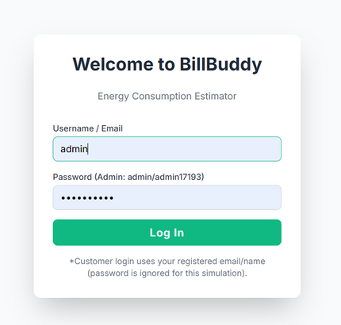
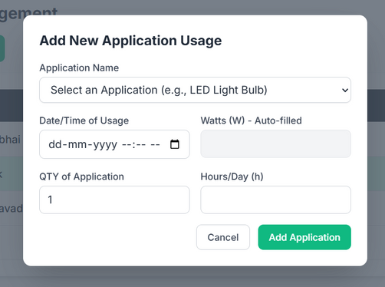
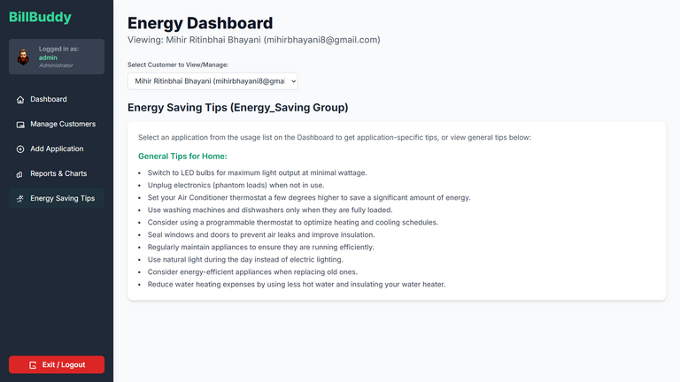
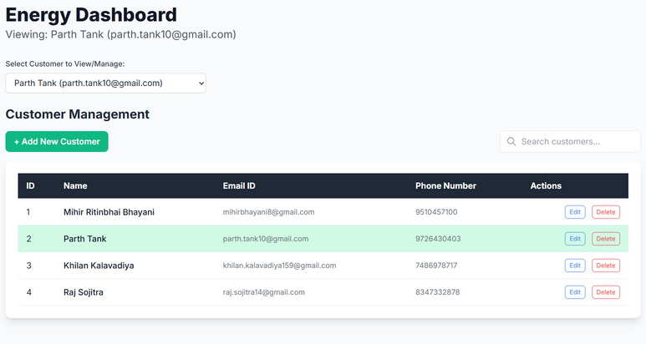
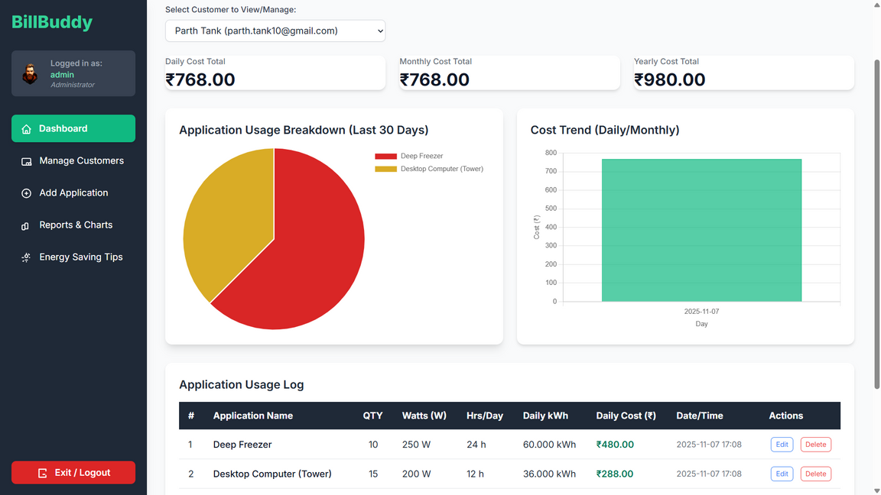
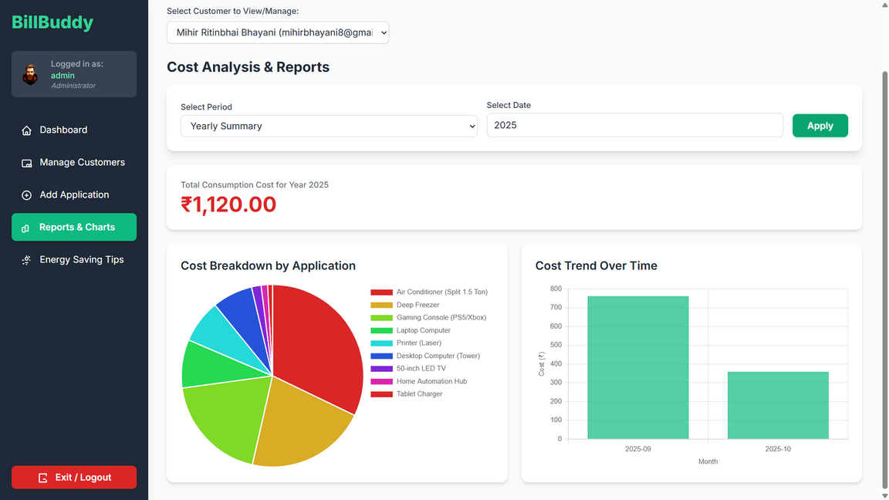
Output
&
Results

Slide 12

Conclusion :
Energy Consumption Estimator
The Energy Consumption Estimator is a complete web-based system that efficiently calculates, monitors, and analyzes household or commercial electricity usage. It integrates HTML, CSS, and JavaScript for a modern interactive frontend, Python (Flask) for backend logic, and SQLite3 for structured data storage. The system allows admins to manage customers, track appliance data, view real-time charts, generate PDF reports, and provide personalized energy-saving tips. By combining automation, visualization, and sustainability, this project helps users understand their power consumption, reduce unnecessary energy costs, and promote smart, eco-friendly energy management in a simple and efficient way.

Slide 13
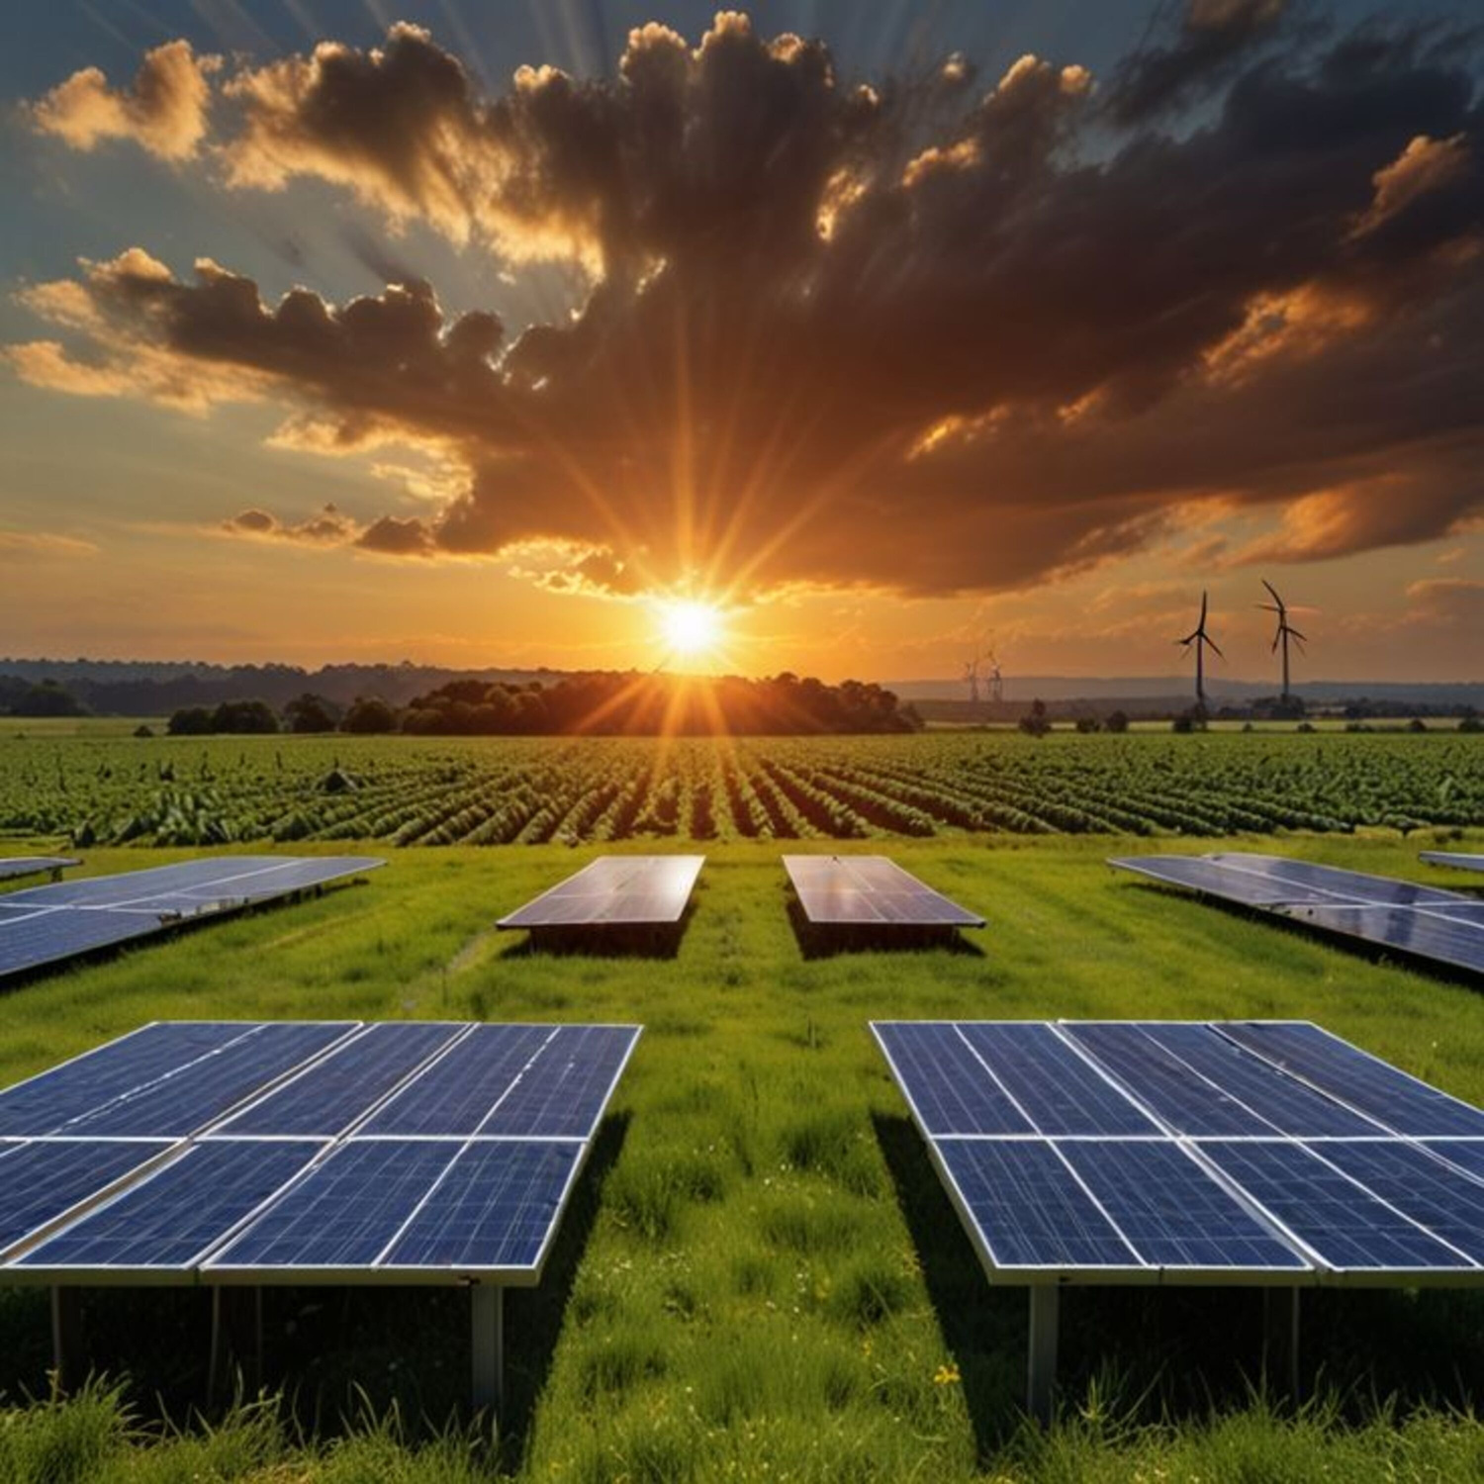
Future
Enhancements
In the future, the Energy Consumption Estimator can be upgraded with advanced features to make it more intelligent, automated, and user-centric. Integration of machine learning algorithms can help predict energy consumption patterns and provide smart cost-saving suggestions. The system can also connect with IoT-based smart meters or sensors to track real-time electricity usage automatically. Additional improvements like role-based authentication, cloud database integration, and mobile app support can enhance accessibility and scalability. By implementing these advancements, the project can evolve into a complete smart energy management solution that promotes sustainable living and efficient resource utilization.

Slide 14


